Slide 1
Financial Analytics For Business
BlackRock – The Financial Titans

Slide 2




Table of Contents
Company Introduction
Ratio and Valuate Analysis
Technical Analysis
Recommendations
References

Slide 3
Team Introduction
Urali Virajsinh Rana
Devkumar Patel
Vatsalkumar Patel
Pramit Parikh
Rajan Patel

Slide 4
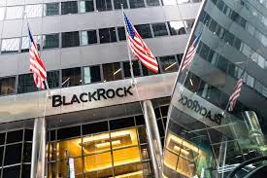
Company’s Introduction
Welcome to the presentation on BlackRock.
BlackRock: Leading the Way in Investment Management
BlackRock is a leading investment management firm with a global presence.
This presentation will cover the company's history, products and services offered, mergers and acquisitions, industrial competitors, and approximate market share of the company and competitors.

Slide 5

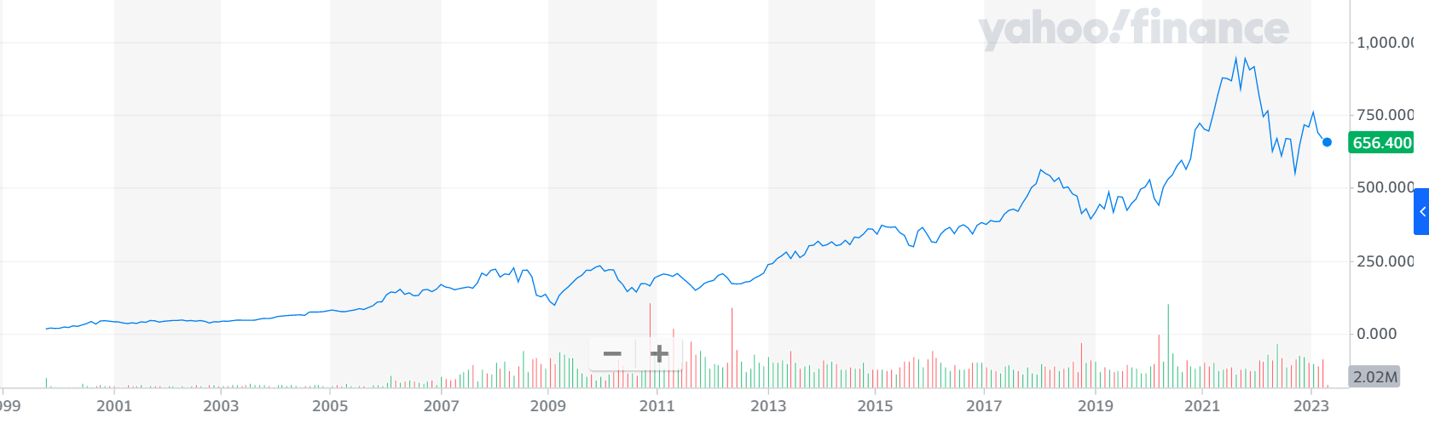

Company Information
BlackRock is a Financial GIANT, with the largest investor on planet earth with over $10 Trillion in assets.
BlackRock manages assets equal to 1/10th of Global Economic Activity
After its IPO in 1999 its stock has increased by 9698%.
It owns 5% or more in most S&P500 companies.
Nearly 60% is of Assets Under Management(AUM) is for Institutional Investors.

Slide 6
Company Information
BlackRock’s secret weapon is an advanced trading algorithm called ALADDIN (Asset, Liabilities, Debt, and Derivative Investment Network).
Aladdin is a risk-evaluation and risk-management system including 5000 computers that work 24x7, managed and monitored by a group of engineers, mathematicians, and developers.
During the 2008 global financial crisis, Aladdin was called upon by every major bank, as well as the head of the Fed Reserve and US Treasury.
Aladdin played a key role in the recession by saving the financial market from complete collapse.

Slide 7
Company’s History
From Fixed-Income Asset Manager to Global Investment Management Firm
In 1988, BlackRock, a fixed-income asset management, was established in New York City.
The business has grown into additional asset classes over time, including stocks and alternative assets.
PNC Financial Services Group purchased shares in BlackRock in 1999, and the business went public on the New York Stock Exchange in 2006. (NYSE) for $14 a share.
By the end of that year, the firm had $165 billion in assets under management due to its strengthening relationships with global institutions.
Recognizing the opportunity to bring transparency, scale and innovation to risk management for the broader industry, BlackRock begins to sell its proprietary technology, Aladdin.
BlackRock founds BlackRock Solutions, with Aladdin as the basis for the business. This marked the beginning of BlackRock’s role as a technology provider.

Slide 8
Company’s History
From Fixed-Income Asset Manager to Global Investment Management Firm
2006 - BlackRock acquires Merrill Lynch Investment Management, expanding its retail and international presence.
2008 - Amidst the financial crisis, the Head of the Federal Reserve Bank of New York asks BlackRock to analyze Bear Stearns' mortgage-backed securities assets and determine their value. BlackRock plays a key advisory role to institutions across the globe seeking to navigate the financial crisis.
2009 - BlackRock acquires Barclay's Global Investors (BGI), becoming the world's largest asset manager, with employees in 24 countries. With this acquisition, BlackRock makes the unprecedented move of bringing alpha and index strategies under one roof to provide a wider breadth of solutions for its clients.
2018 - BlackRock launches its first AI Lab in Palo Alto to accelerate its use of artificial intelligence and associated disciplines – machine learning, data science, natural language processing – to improve outcomes and drive progress for investors, clients and the firm.

Slide 9
Company’s Products and Services
Mutual funds, exchange-traded funds (ETFs), individually managed accounts, and alternative investments are just a few of the investment services and products provided by BlackRock.
Moreover, BlackRock provides its clients with consulting and risk management services.
BlackRock offers the size and experience to fulfil the needs of individual investors, institutions, and governments globally.
BlackRock now manages more than $10 trillion in assets.

Slide 10
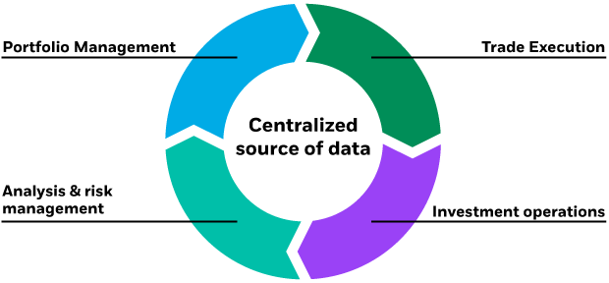
Company’s Products and Services
Portfolio Management - We construct active asset allocation strategies and whole portfolio solutions across a wide spectrum of commingled funds, separate accounts, model portfolios and outsourcing solutions in the wealth and institutional channels.
Trade Execution - BlackRock’s trade execution model involves the centralization of its trading platform, whereby orders are routed to specialized trading desks
Analysis & Risk Management - The Risk and Quantitative Analysis (RQA) team, which evaluates and manages risk based on the controls put in place by main risk owners, as well as Compliance and Financial Controls, are only a few of BlackRock's independent risk and control operations.
Investment operations - Get familiar with the company's many business divisions and investment options. Provide the knowledge and cutting-edge solutions of BlackRock to customers by working with teams throughout the company.• Look for inefficiencies in systems, processes, and procedures, and offer suggestions for change.

Slide 11

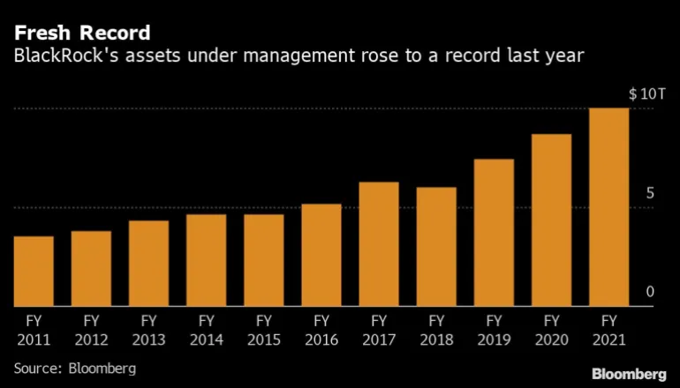
Company’s Assets Under Management (AUM)

Slide 12
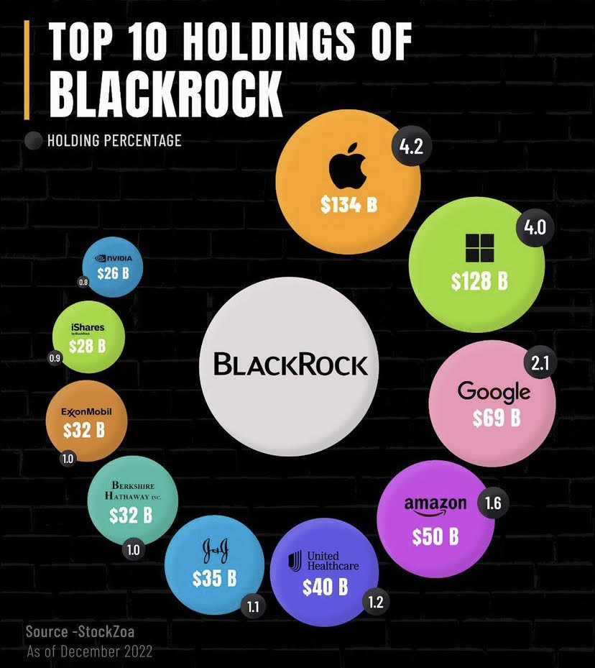
Company’s Investments
In total company has invested in 4973 companies.

Slide 13
BlackRock Mergers and Acquisitions
Number | Acquisition date | Company | Country | Price (USD) | Used as or integrated with
1 | 10-Feb-06 | Merrill Lynch Investment Management | US | $9.3B | Retail and international presence
2 | 12-Jan-09 | Barclays Global Investor | US | $13.5B | ETF
3 | 15-Jan-10 | Helix Financial Group LLC | US | - | CRE
4 | 25-Aug-15 | FutureAdvisor | US | $150M | Robo-advisory
5 | 09-Jun-17 | Cachematrix | US | $200M | Liquidity management
6 | 08-Jan-18 | Tennenbaum Capital Partners | US | $9M | Private credit
7 | 24-Sep-18 | Asset Management Business of Citibanamex | US | $350M | Fixed income, equity, and multi-asset funds holding
8 | 05-Oct-19 | eFront Alternative Investment Solutions | US | $1.3B | Alternative investment management solutions

Slide 14
Industrial Competitors
Several other investment management companies, such as Vanguard Group, State Street Global Advisors, Fidelity Investments, Capital Group, and T. Rowe Price, compete with BlackRock.
These businesses compete on pricing, performance, and customer service while providing a variety of financial products and services.
BlackRock, however, has a competitive advantage over many of its rivals due to the size, knowledge, and worldwide reach of the company.

Slide 15
Market Share
A Leader in the ETF Market, but Challenges Remain
As of December 2021, BlackRock has a market share of around 27.4% of the world's ETFs, according to statistics.
With a market share of 18.8%, Vanguard was the second-largest ETF supplier, and State Street Global Advisors was third with a share of 15.8%.
According to data from Morningstar, BlackRock has a market share of around 6.7% for actively managed mutual funds in the US as of December 2021.
With a 22.9% market share, Vanguard held the top spot in this market, followed by Fidelity Investments with a 15.6% share.

Slide 16
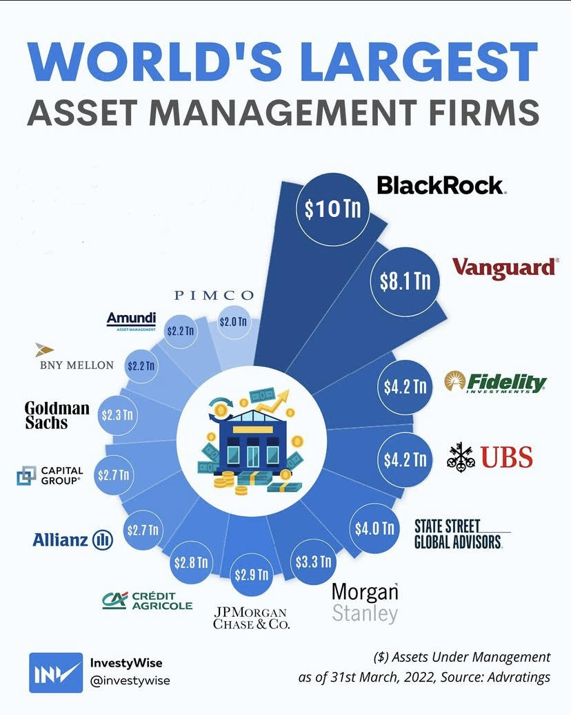
Market Share

Slide 17
Ratio Analysis

Slide 18
Ratio Analysis

Slide 19
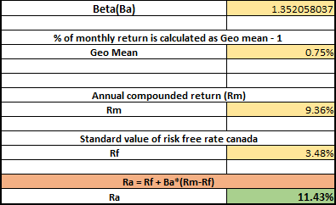
CAPM Analysis
Here, the calculation of CAPM (Capital Asset Pricing Model) with a risk-free ratio of 3.48% as of April 01, 2023, is 11.43%.
Beta value depends on S & P 500 and blackrock. More volatile. CAPM to get the actual return > market return s &p

Slide 20
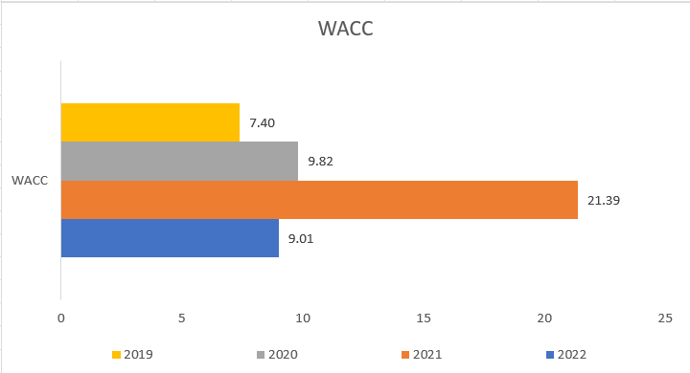
Weighted Average Cost of Capital (WACC)
This is the Weighted Average Cost of Capital for the year 2019 to 2022.

Slide 21
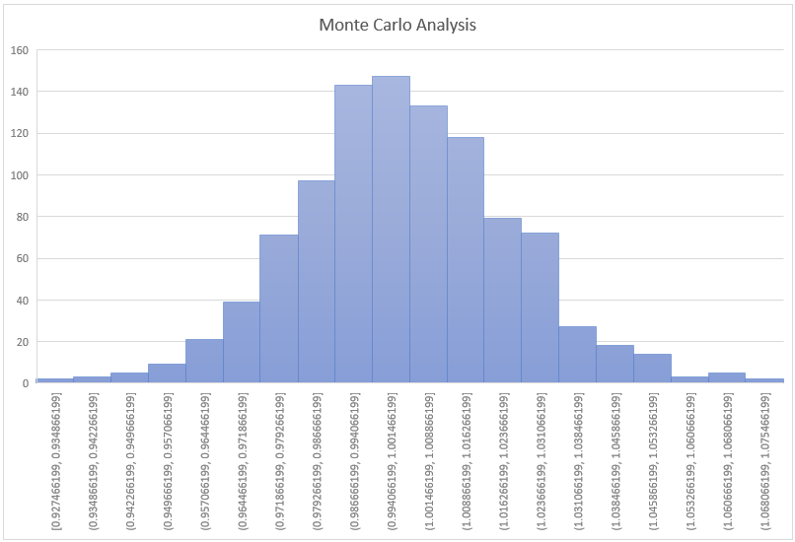
Monte Carlo Simulation
The Monte-Carlo simulation represents the normal distribution (a bell-shaped curve) in which almost all the data points fit perfectly.

Slide 22
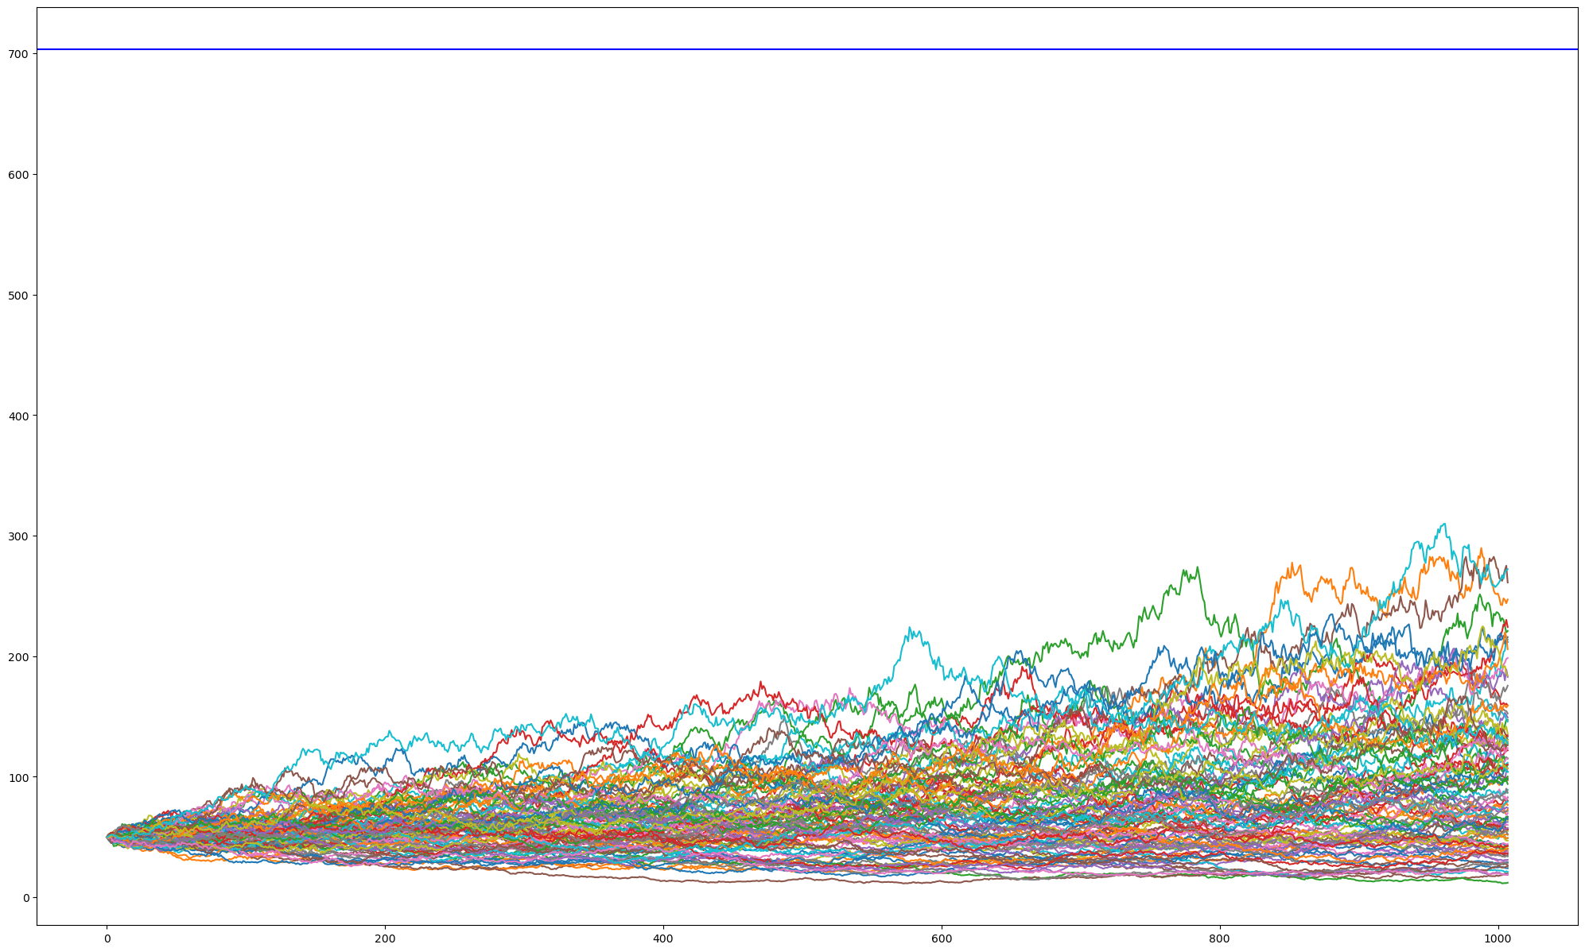
Monte Carlo Simulation

Slide 23
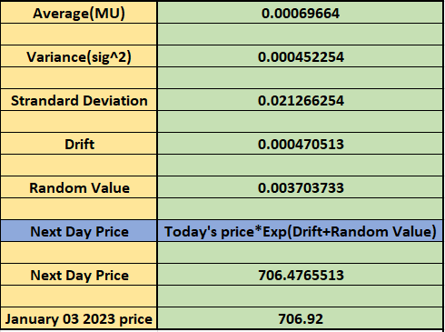
Brownian Method Simulation
The Brownian method is for calculating the next day’s stock price which on comparison was accurate to the next day’s real price.

Slide 24
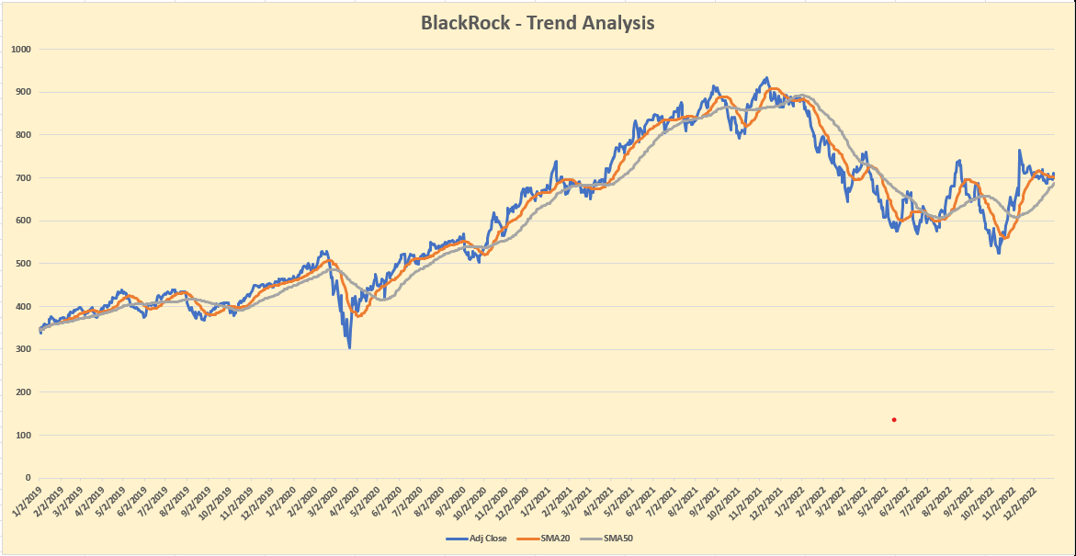
Trend Analysis
Here the Trend Analysis is being created with 20-SMA and 50-SMA indicators.

Slide 25
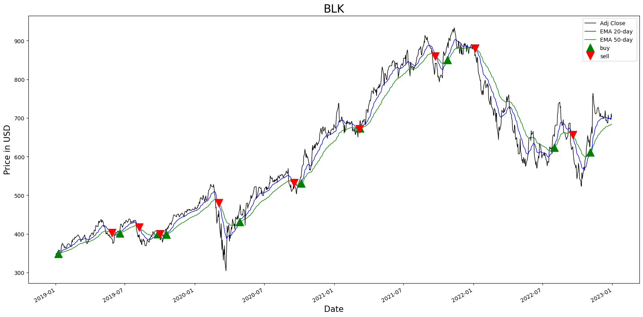
Time Series
The Time Series method is used to generate the buy and sell signal based on the trend changing over time to book profit
and re-enter during the dip.

Slide 26
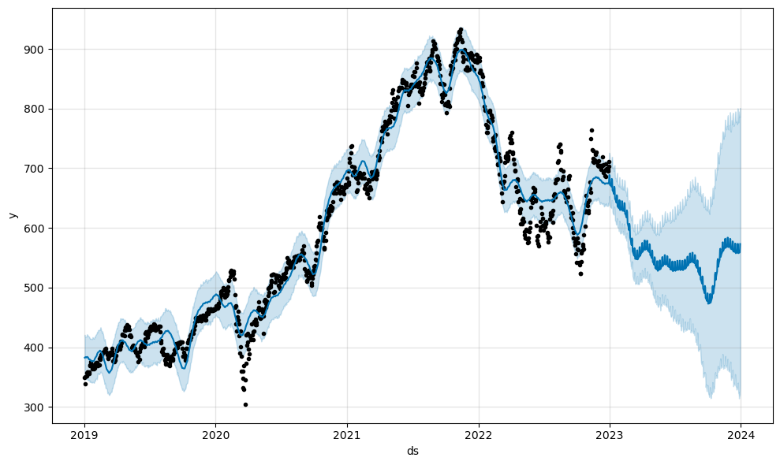
Facebook Prophet

Slide 27
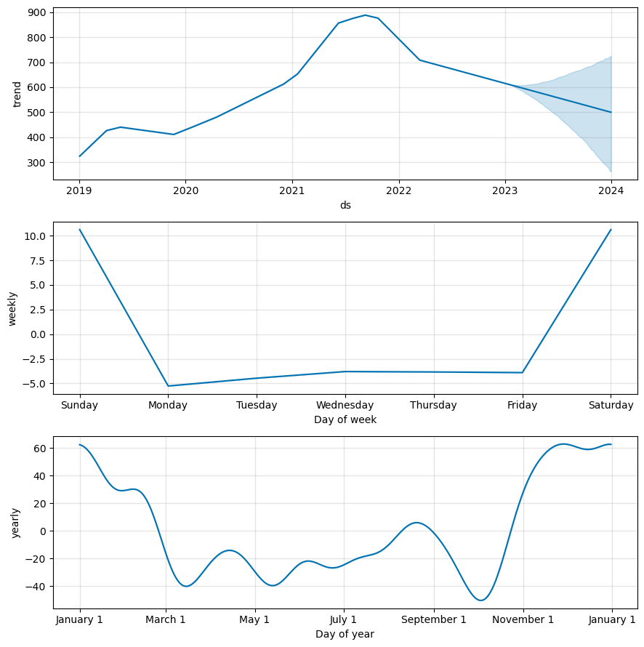
Facebook Prophet
This method is used to forecast the time-series method.
Based on the Bayesian approach it includes trend, seasonality, and holiday effects.
It is also used to predict the yearly, monthly, and weekly as well.

Slide 28
Recommendations & Conclusion
Leading investment management company BlackRock has a lengthy track record of providing value to its clients.
The business has been able to keep its position as a market leader because of its diversification into other asset classes, as well as its emphasis on risk management and advisory services.
BlackRock will need to keep innovating and adapting to shifting market conditions in order to stay ahead of its competitors, albeit industry rivalry is still fierce.

Slide 29
References
Here are some sources for further reading on BlackRock and the investment management industry:
BlackRock website: https://www.blackrock.com/
Morningstar: https://www.morningstar.com/
Financial Times: https://www.ft.com/
Wall Street Journal: https://www.wsj.com/
Yahoo Finance: https://ca.finance.yahoo.com/quote/BLK?p=BLK

Slide 30


